Slide 1
Science Fair Topics
The Two R’s: Rigorous and Relevant
Gifted/Advanced Level
Original
Complex
Meaningful
Data-driven

Slide 2
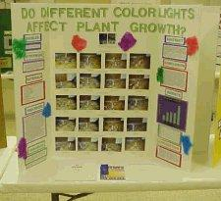
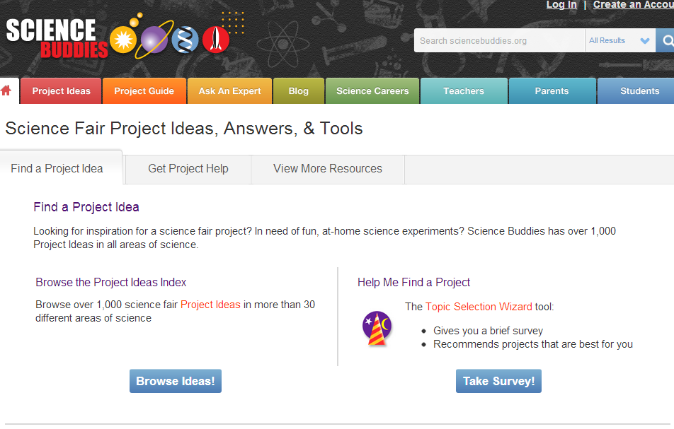
Project Quality: Selecting a Project
Generic student projects
Students with the same project
Low-level Topics
Often come from sites like Science Buddies

Slide 3
Topic Selection: Your project topic is NO GOOD if…
I can Google search for your topic and it comes up
your project involves too simple of procedures
It’s a “beginner” project from Science Buddies
you find a topic that is similar to one that already exists, but you DO NOT make it your own (it needs to be original) ie mentos…melting ice…candy..etc.
you did it in elementary school or in a class lab

Slide 4
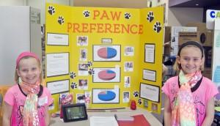
Project Quality: Selecting a Project
Relevance
Should have some real-world applications
Make it meaningful
Start with research on real problems or a useful topic that would matter to many people
The only person who cares if your dog is right or left handed is probably you.

Slide 5
Selecting a Project: Make it Personal
Make it unique?
Is something that is relevant to you?
What are your hobbies?
Interests?
What do your parents do?

Slide 6
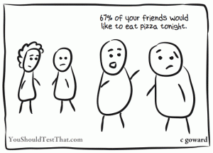
Project Quality: Selecting a Project
Large sample size
Generate quality data
You NEED DATA
Statistical tests

Slide 7
Project Quality: Selecting a Project
High level projects to work in categories that require:
Extra forms
SRC/IRB Approval
Qualified Scientists
You cannot do a special project if the paperwork isn’t in order FIRST.

Slide 8
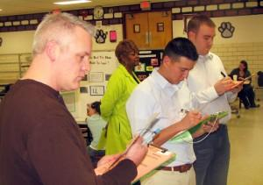
Project Quality: Judging Interviews
Students should be able to answer the following questions about their project:
What is their control?
What is their independent variable?
What is their dependent variable?
Explain the rationale behind their data collection?

Slide 9
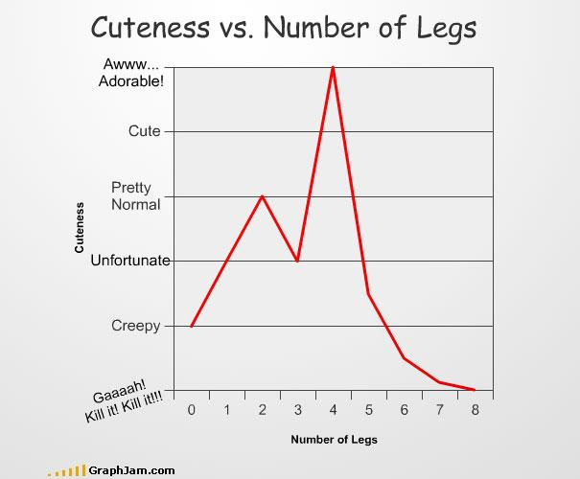
Project Quality: Judging Interviews
Students should be able to do the following data analysis:
Simple projects:
Averages and Standard Deviations
More complex projects:
t-test, ANOVA, Chi-square
The key to having good data analysis is a LARGE sample size.

Slide 10
What is not acceptable:
ANYTHING from a kids website or from elementary or middle school labs
Anything easy enough for a 5th grader to do
Anything that can cause harm
Models (ie volcanos)

Slide 11
Good Projects from the Past
How Does the Different Size of Ammunition Effect the Size of Breakage of the Clays?
The Effect of Eye Dominance on Reading Ability
Effects of Peer Pressure on Class Behavior
How the music in a video affects memory retention
Browser Wars: Which Internet browser loads content the fastest?
The tennis ball Dimple Effect on an Airplane
Note: Human Projects – need A LOT of people to test

Slide 12
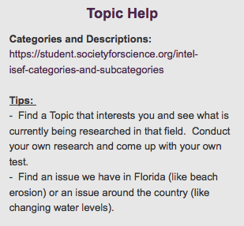
On Class Website…
Review the Topic Help Section and Look at the Science Fair Official Categories for topic ideas.

